Slide 1

Styling
Cascading Style Sheets

Slide 2
CSS (Cascading Style Sheet)
CSS stands for Cascading Style Sheets.
It is a style sheet language which is used to describe the look and formatting of a document written in markup language.
It provides an additional feature to HTML.
It is generally used with HTML to change the style of web pages and user interfaces.

Slide 3
Components of CSS
Selector : A Selector is a html tag at which a style will be applied. Eg: <h1>
Property : A property is a type of attribute of html tag. Eg: color,border
Value : Values are assigned to properties. Eg: color:pink

Slide 4
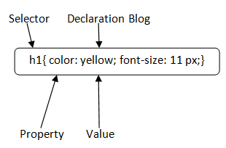
CSS Syntax
A CSS rule set contains a selector and a declaration block.
Selector: Selector indicates the HTML element you want to style. It could be any tag like <h1>, <title> etc

Slide 5
Declaration Block:
The declaration block can contain one or more declarations separated by a semicolon. For the above example, there are two declarations:
color: yellow;
font-size: 11 px;
Each declaration contains a property name and value, separated by a colon.

Slide 6
Property and Value
A Property is a type of attribute of HTML element. It could be color, border etc.
Values are assigned to CSS properties. In the above example, value "yellow" is assigned to color property.
Selector{
Property1: value1;
Property2: value2;
..........;
}

Slide 7
HTML style Attribute
The style attribute specifies an Inline style for an element.
The style attribute will override any style set globally, e.g. styles specified in the <style> tag or in an external style sheet.
Eg:
<h1 style="color:blue;text-align:center">This is a header</h1> <p style="color:green">This is a paragraph.</p>

Slide 8
HTML Style Tag
The html <style> tag contains the style information of the document, or it is a part of a document.
<style> tag contains the CSS which is used for styling the Web Page.
<style> ...content here </style>

Slide 9
Types of CSS
Inline CSS
Internal or Embedded CSS
External CSS

Slide 10
Inline CSS
Inline CSS contains the CSS property in the body section attached with element is known as inline CSS.
This kind of style is specified within an HTML tag using the style attribute.
Eg: <p style = "color:#009900; font-size:50px; font-style:italic; text-align:center;">Welcome</p>

Slide 11
Internal or Embedded CSS
The internal style sheet is used to add a unique style for a single document. It is defined in <head> section of the HTML page inside the <style> tag.
Eg <head>
<style>
h1 {
color: red;
margin-left: 80px; }
</style>
</head>
<body>
<h1>The internal style sheet is applied on this heading.</h1>
</body>

Slide 12
External CSS
The external style sheet is generally used when you want to make changes on multiple pages. It is ideal for this condition because it facilitates you to change the look of the entire web site by changing just one file.
It uses the <link> tag on every pages and the <link> tag should be put inside the head section.
Eg: <head>
<link rel="stylesheet" type="text/css" href="mystyle.css">
</head>

Slide 13
External CSS
The external style sheet may be written in any text editor but must be saved with a .css extension. This file should not contain HTML elements
Let's take an example of a style sheet file named "mystyle.css".
File: mystyle.css
body {
background-color: lightblue;
}
h1 {
color: navy;
margin-left: 20px;
}

Slide 14
Styling Properties

Slide 15
1. Background-Color
With this CSS property we can set the background color for any HTML element like <div>, <h1> etc.
Example:
<h1 style="background-color:blue">My background is blue</h1>

Slide 16
2. Color
The font color of the text in an HTML element can be controlled by setting its color attribute to the right color name or HEX code, or RGB code.
Example
<h1 style="color:blue">My font color is blue</h1>
Output:

Slide 17
3. Border Color
We can set the border color of any HTML element if we’d like to add a border to it.
Example
<p style="border: 1px solid red">My border is red</p>
Output:

Slide 18

4. Background-Image
We can also set an image as a background by using the background-image property as follows:
Example:
<body style="background-image: url('https://www.google.com/images/branding/googlelogo/2x/googlelogo_color_272x92dp.png');height :365px">
Output:

Slide 19

5. Background-Repeat
when an image is set as background using the background-image property, it by default repeats the image both horizontally as well as vertically. However, some images may need to be repeated either vertically or horizontally.
This behavior can be controlled by setting the desired value against the property of background-repeat.
The value “repeat-x” is used to allow the image to be repeated only horizontally.
The value “repeat-y” is used to allow the image to be repeated only vertically.
The value “no-repeat” is used to stop any kind of repetition of the background image.
Eg: <div style="background-image: url('https://www.google.com/images/branding/googlelogo/2x/googlelogo_color_272x92dp.png');height :365px; background-repeat:no-repeat">
Output:

Slide 20

6. Background-Position
Example
<body style="background-image: url('https://www.google.com/images/branding/googlelogo/2x/googlelogo_color_272x92dp.png');height :365px; width:500px;background-repeat: no-repeat; background-position: left bottom;">
</div>
Output:

Slide 21
HTML Colors
HTML colors are specified with predefined color names, or with RGB, HEX, HSL, RGBA, or HSLA values.
Color Values
In HTML, colors can also be specified using RGB values, HEX values, HSL values, RGBA values, and HSLA values.
rgb(255, 99, 71), #ff6347, hsl(9, 100%, 64%)
background color set with RGBA and HSLA values, which adds an Alpha channel to the color (here we have 50% transparency):
rgba(255, 99, 71, 0.5)hsla(9, 100%, 64%, 0.5)

Slide 22
1.RGB Color Values
An RGB color value represents RED, GREEN, and BLUE light sources.
An RGBA color value is an extension of RGB with an Alpha channel (opacity).
rgb(red, green, blue)
Each parameter (red, green, and blue) defines the intensity of the color with a value between 0 and 255.(256 x 256 x 256 = 16777216 possible colors!)

Slide 23
RGB Color
Red - rgb(255, 0, 0)
Green - rgb(0, 255, 0)
Blue - (0,0,255)
Black -(0,0,0)
White - (255,255,255)

Slide 24
RGBA Color Values
RGBA color values are an extension of RGB color values with an Alpha channel - which specifies the opacity for a color.
An RGBA color value is specified with:
rgba(red, green, blue, alpha)
The alpha parameter is a number between 0.0 (fully transparent) and 1.0 (not transparent at all):

Slide 25
2.HEX Colors
A hexadecimal color is specified with: #RRGGBB, where the RR (red), GG (green) and BB (blue) hexadecimal integers specify the components of the color.
color values
#rrggbb
Where rr (red), gg (green) and bb (blue) are hexadecimal values between 00 and ff (same as decimal 0-255)
For example, #ff0000 is displayed as red, because red is set to its highest value (ff), and the other two (green and blue) are set to 00.

Slide 26
HEX Colors
Red - #ff0000
Green - #00ff00
Blue - #0000ff
Black - 000000
white - ffffff

Slide 27
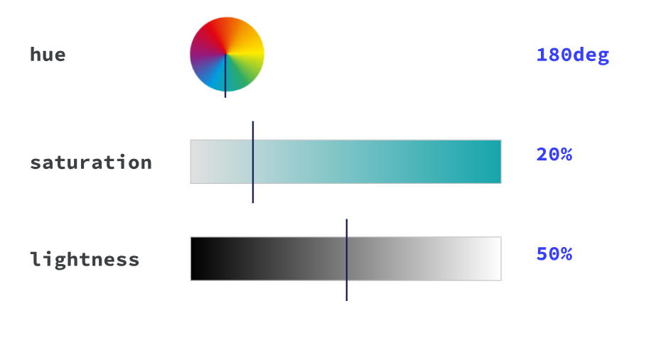
3.HSL and HSLA Colors
HSLA color values are an extension of HSL with an Alpha channel (opacity).
HSL Color Values - hsl(hue, saturation, lightness)
In HTML, a color can be specified using hue, saturation, and lightness (HSL)
Hue is a degree on the color wheel from 0 to 360. 0 is red, 120 is green, and 240 is blue.
Saturation is a percentage value, 0% means a shade of gray, and 100% is the full color.
Lightness is also a percentage value, 0% is black, and 100% is white.

Slide 28
HSLA Color Values
hsla(hue, saturation, lightness, alpha)
The alpha parameter is a number between 0.0 (fully transparent) and 1.0 (not transparent at all)
Eg: Color picker

Slide 29
Div Tag
The div tag is known as Division tag.
The div tag is used in HTML to make divisions of content on the web page like (text, images, header, footer, navigation bar, etc).
Div tag has both opening(<div>) and closing (</div>) tags and it is mandatory to close the tag.
Eg: <div>Welcome</div>

Slide 30
Span Tag
The HTML span element is a generic inline container for inline elements and content.
It used to group elements for styling purposes (by using the class or id attributes).
A better way to use it when no other semantic element is available.
The span tag is very similar to the div tag, but div is a block-level tag and span is an inline tag.
<h1> <span>Welcome</span> to Luminar </h1>

Slide 31
CSS Layout - float
The CSS float property specifies how an element should float.
The float property is used for positioning and formatting content e.g. let an image float left to the text in a container.
The float property can have one of the following values:
left - The element floats to the left of its container
right - The element floats to the right of its container
none - The element does not float (will be displayed just where it occurs in the text). This is default
inherit - The element inherits the float value of its parent

Slide 32
TASKS
Difference between div and span
What is CSS3?, Features, Advantages , Uses and Needs

